Slide 1
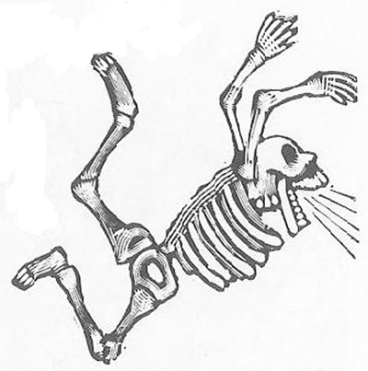
Responding to NIH Grant Reviews
Christopher J. Hernandez, Ph.D.
Associate Professor
Sibley School of Mechanical and Aerospace Engineering
Department of Biomedical Engineering
Cornell University
Adjunct Assistant Scientist, Hospital for Special Surgery
hernandezresearch.com
Cornell –HSS
Program in Biomechanics

Slide 2
Hernandez Grant Writing Strategy
Get Grant If I don’t get grant:
Get Useful Criticisms
Fewer criticisms more likely to get grant
Make problems hard to find
Writing Clarity: Provide good conceptual model & overview, reviewers can’t confuse what you propose

Slide 3
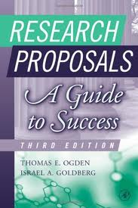
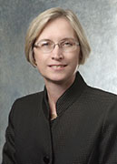
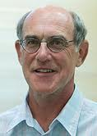
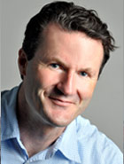
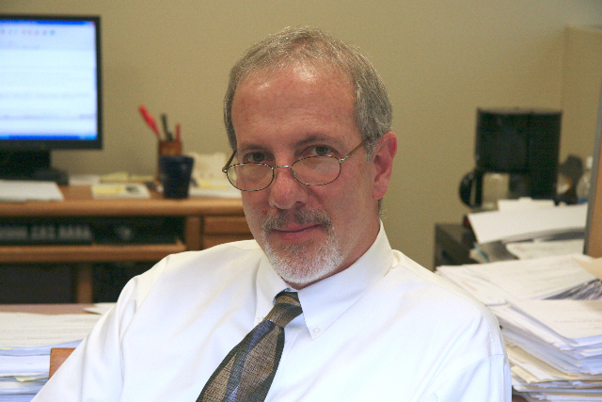
Grant Writing Style
Mentors
Ogden and Goldberg

Slide 4
Think Like A Reviewer
Wants to Minimize Time Spent Reviewing
Professional Scientist
Does not know your work as well as you
Follows “Guidelines for Reviewers”
Will not mention all errors, only enough to justify score

Slide 5
What to Do When you Get Summary Statement
Read
Wait until you are no longer angry
Highlight all Negative Criticisms
Order Criticisms by Importance
Identify Criticisms that Need More Data
Identify Criticisms that just need Rewording

Slide 6
Critique 2:
Failure By Author
Fatal Flaw Elsewhere in Grant, no need to play close attention elsewhere
Is the grant in the right study section?

Slide 7
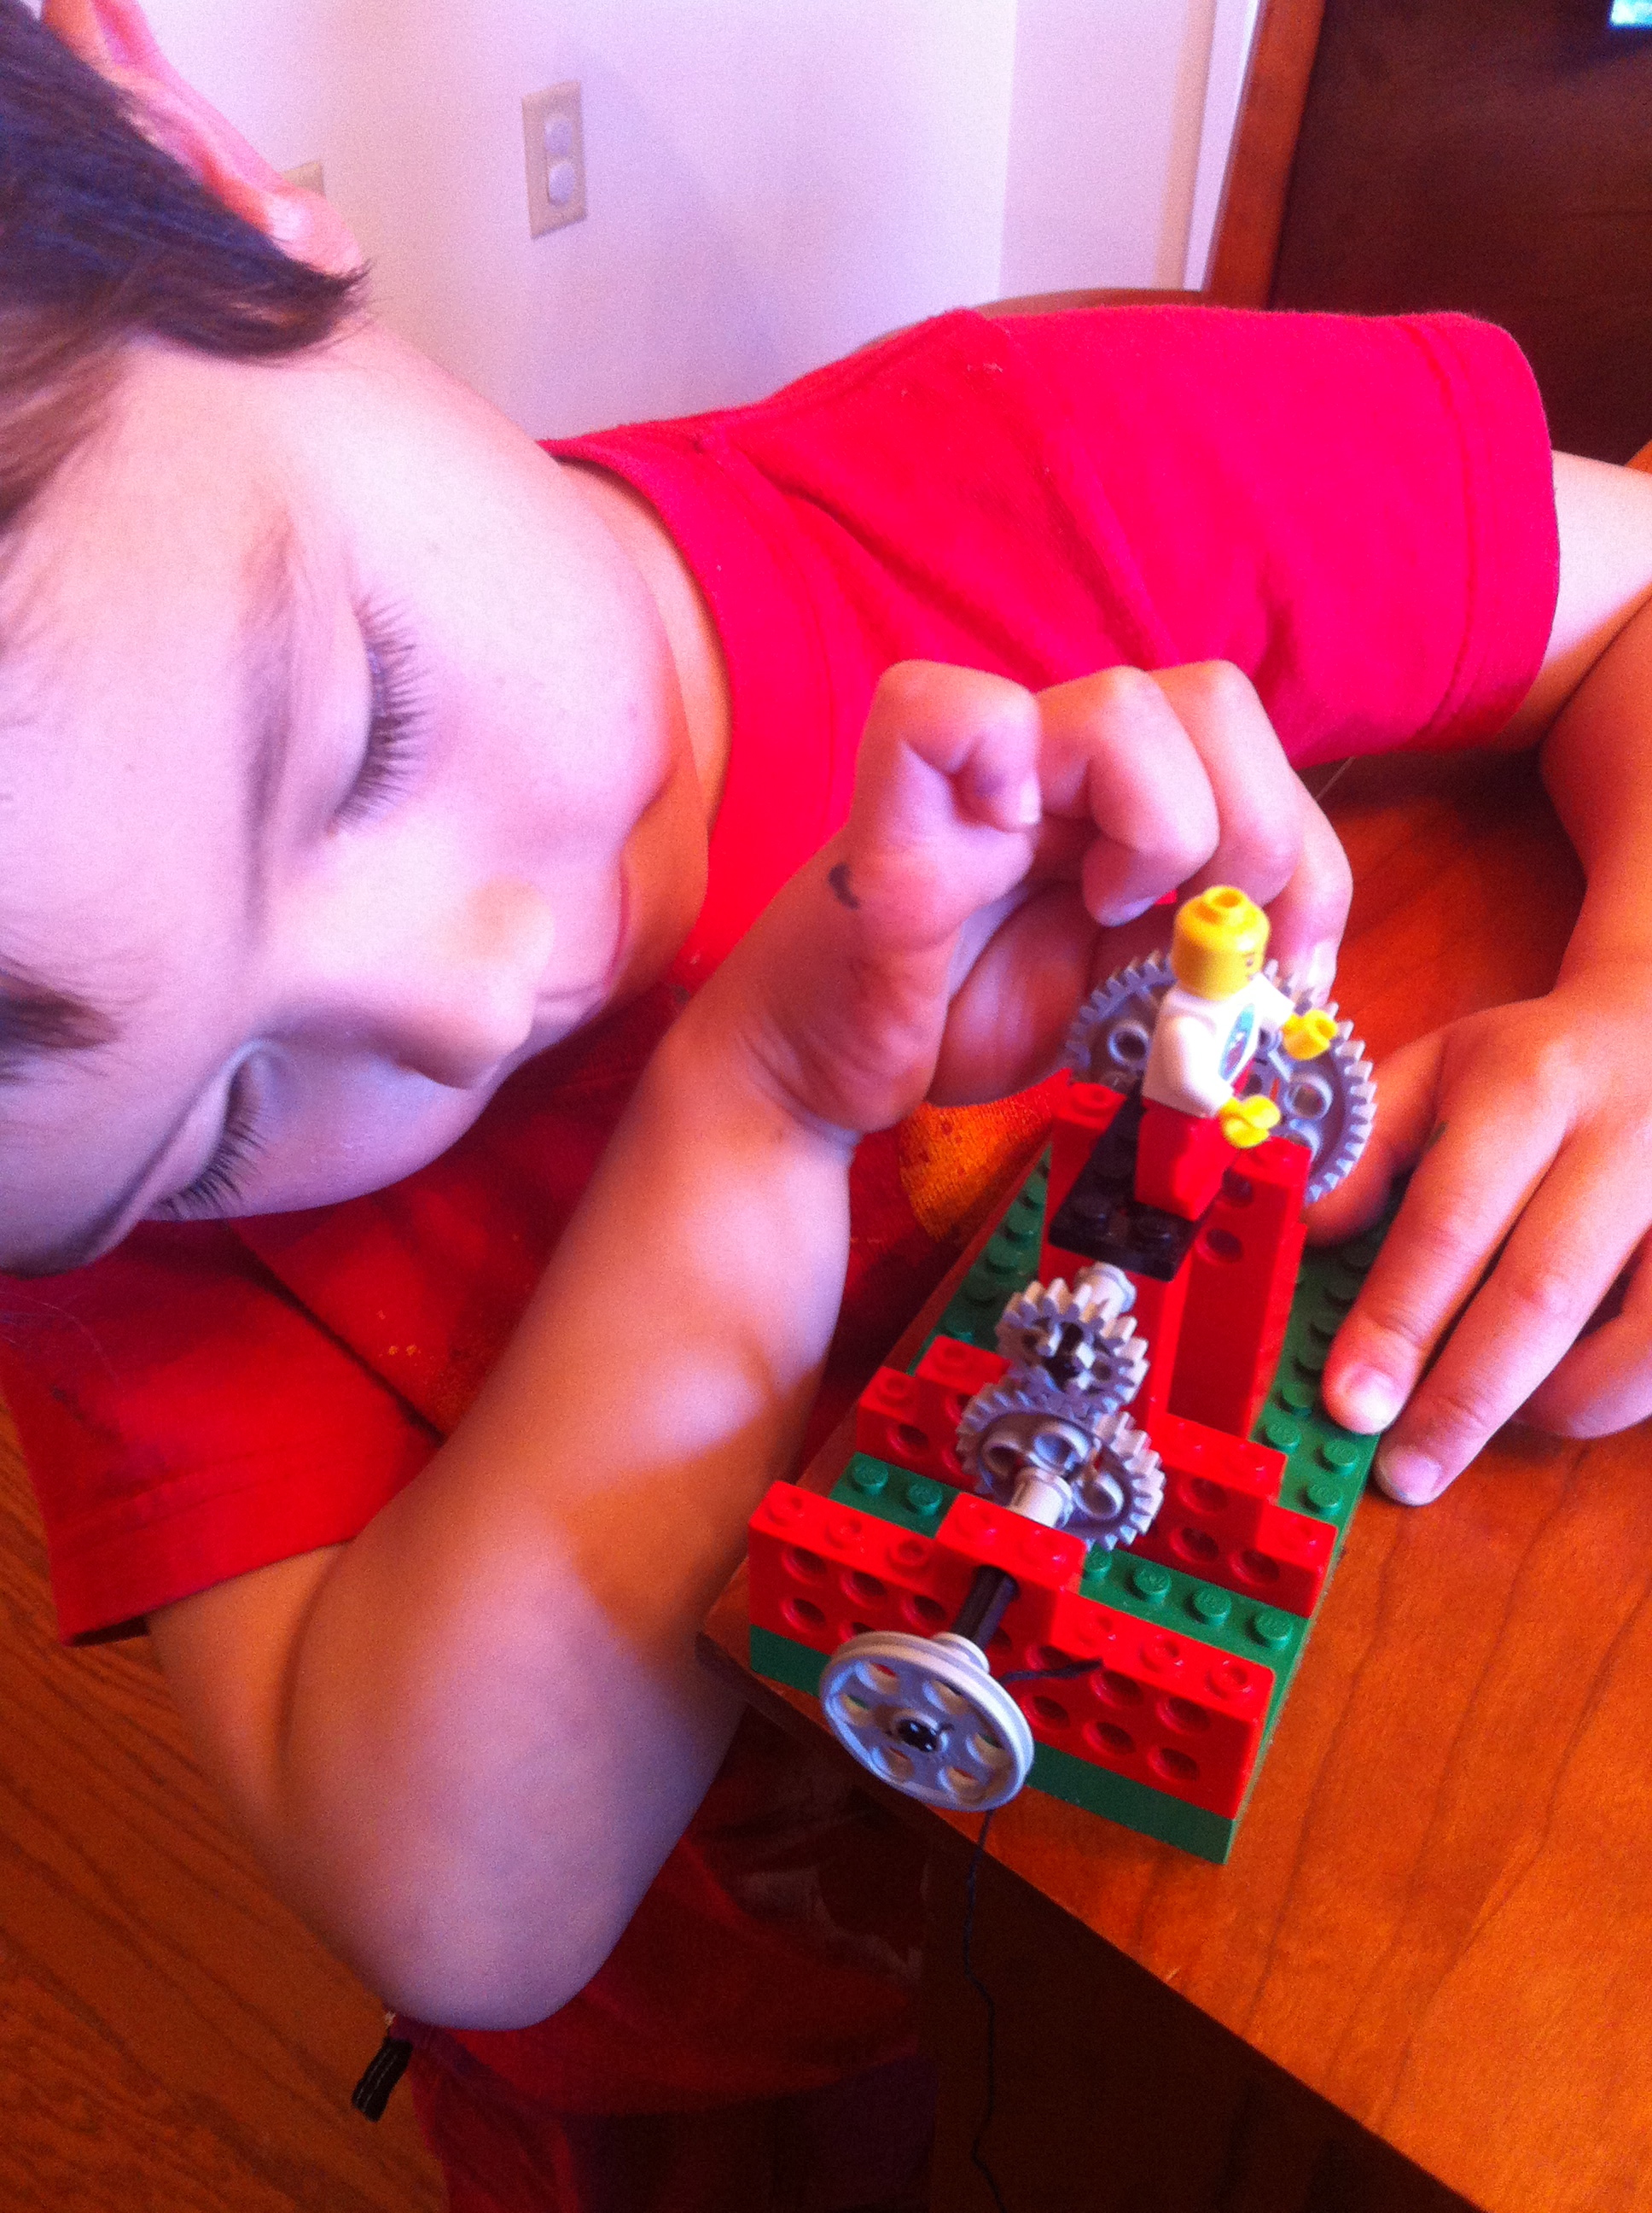
Preparing Introduction
Quote Each Criticism
Respond with:
New Preliminary Data
Make Recommended Changes
Citations of Work by Others Supporting your Point
Do Not:
Say reviewer is wrong / didn’t read grant
Point out errors by reviewer
Make arguments without support from citations/prelim data

Slide 8
Revision Scoring
NIH Study Sections Do Not Like to Give a Worse Score to a Responsive Resubmission
Does not mean your score will get good enough for funding
Common Reason For Small Score Improvement
Conceptual Model Limited
New Material is Flawed
Long-term Utility of Work is Limited

Slide 9
