Slide 1
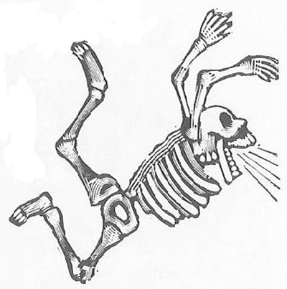
Finding Your Faculty Job
Christopher J. Hernandez, Ph.D.
Associate Professor
Sibley School of Mechanical and Aerospace Engineering
Meinig School of Biomedical Engineering
hernandezresearch.com
Cornell –HSS
Program in Biomechanics

Slide 2
Online Resources
Tomorrow’s Professor
Columbia University Diversity Office
http://facultydiversity.columbia.edu/tips-applying-faculty-positions

Slide 3
Think about yourself
What is it about the job that really gets you excited?
What do you want to be known for in 10 years?

Slide 4
Think about the people evaluating your application
Who are they?
How long have they been working on the faculty search?
What are the things that are most important?
Do they all agree with each other?

Slide 5
A Faculty Search is a Year Long Project
Department
Identifies Need
And Topic
Department writes
Announcement
1-2 weeks
Dean Approves
Search (Funds)
Weeks to Years
Department Collects
And Reviews Applications
2-4 weeks
Position Negotiation
1-2 months
Search Committee
Creates Short List
Solicits Interviews
Hiring Decision
1-2 weeks
Interviews
2-4 weeks

Slide 6
Costs of Hiring a Faculty Member
Research Intensive?
Teaching Intensive?

Slide 7
Options for Workshop
Faculty Positions: What kind to you want?
Components of the Application
CV
Research Statement*
Teaching Statement
The Interview
Negotiating a Position

Slide 8
Faculty Positions: Where do you fit?
Medical School
Top 5 Research Intensive
Large R1
Research
Small Private
Teaching
Intensive
Teaching
What are the job responsibilities?

Slide 9
Desired Qualifications Differ Among Institutions
Teaching Intensive
How many classes have you taught?
Can you lead student projects?
Are you really a researcher who can’t get another job?
Research Intensive
What kinds of scientific papers have you published?
What research grants will you submit?
How will you contribute to training/center grants?

Slide 10
Your CV
Items on a CV
Education
Awards
Scientific Publications
Conference Proceedings (if not equal to publications)
Teaching Experience (specify TA v. entire course)
Outreach Projects

Slide 11
Example CV

Slide 12
Research Statement
Brief Review of what you have done (short)
Outline overall research goals:
What do you want to be known for in 5 years?
What areas will you approach when you start your lab (including funding possibilities).
Why are you the right person to do this (i.e. your advisor isn’t going to do it

Slide 13
Research Statement
THE RESEARCH STATEMENT IS A GRANT!
It is not a review of your prior publications
It shows how your prior work leads in a new direction

Slide 14
Teaching Statement
Brief Review of what you have done (short)
Outline overall goals:
What do you want to be known for in 5 years?
What areas will you approach when you start your lab (including funding possibilities
Specify existing courses that you could teach.
1-2 pages depending on job application

Slide 15
The Interview
Usually 2 days
30 minute meetings
Research Seminar
“Chalk Talk” Seminar
Example Teaching Lecture
Meals (breakfast, lunch, dinner)

Slide 16
A Job Interview is a Lot of Work for Faculty
Meet with Candidate 30 minutes
Meal with Candidate 1-2 hours
Candidate’s Seminar 1 hour
Candidate’s Job Talk 1 hour
Follow up Faculty Meeting 1 hour

Slide 17
Research Seminar
Somewhat like your dissertation defense
KNOW YOUR AUDIENCE!
1/3 know your field
1/3 have an idea about your field
1/3 only know how your work connects to the undergraduate program

Slide 18
“Chalk Talk” Common at Research Intensive Programs
Summarize your lab vision
What is the big problem you are addressing
Why are you the right person to attack this problem
Discuss 2-3 research projects, hypotheses, aims and research funding targets
Remember you are applying for ~1 million grant
Mention Teaching
Current courses you could teach (include basic engineering)
Mention new specialty courses

Slide 19
Questions you need to ask during the interview
What are the teaching expectations?
How does graduate student support occur?
$$ Cost to support a graduate student (compare to typical grants)
How much TA support (tuition+stipend) is there?
What is summer salary/course buy out policy?
Issues related to life in town

Slide 20
Interview The Good and the Bad

Slide 21
Negotiating Your Package
What do you need to succeed (i.e. perform the work in your research statement)?
Student support?
First semester off from teaching?
When is sabbattical leave?
When do you start?
Moving Expenses?

Slide 22
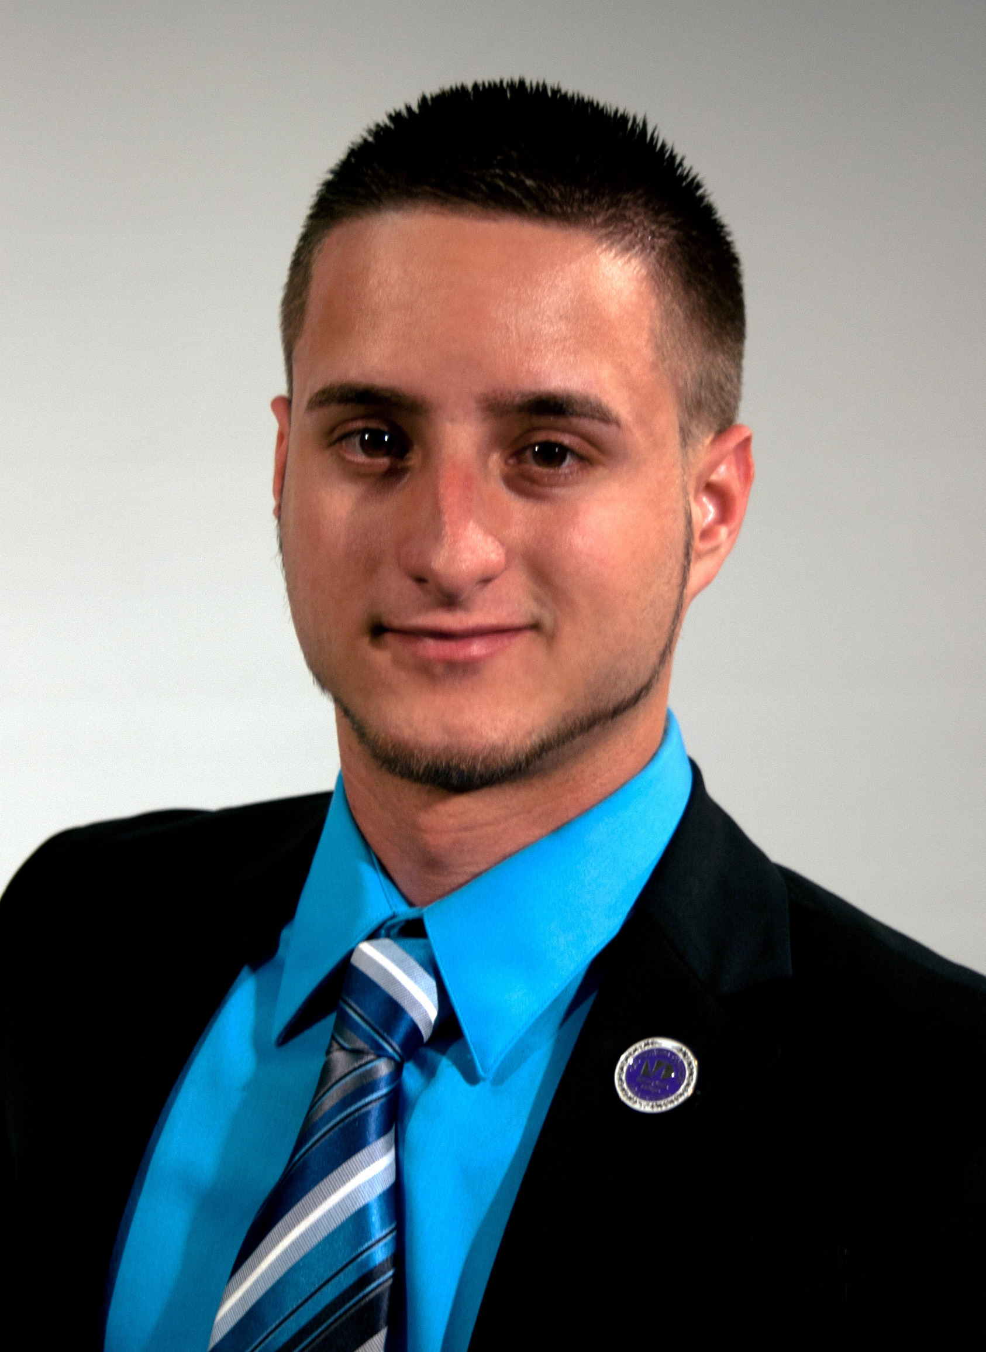
Hernandez Research Group
NIH/NIAMS R21AR068061
DoD CDMRP W81XWH-15-1-0239
NSF CMMI

